Slide 1
Number Systems

Slide 2
Common Number Systems
System | Base | Symbols | Used by humans? | Used in computers?
Decimal | 10 | 0, 1, … 9 | Yes | No
Binary | 2 | 0, 1 | No | Yes
Octal | 8 | 0, 1, … 7 | No | No
Hexa- decimal | 16 | 0, 1, … 9, A, B, … F | No | No

Slide 3
Quantities/Counting (1 of 3)
Decimal | Binary | Octal | Hexa- decimal
0 | 0 | 0 | 0
1 | 1 | 1 | 1
2 | 10 | 2 | 2
3 | 11 | 3 | 3
4 | 100 | 4 | 4
5 | 101 | 5 | 5
6 | 110 | 6 | 6
7 | 111 | 7 | 7
p. 33

Slide 4
Quantities/Counting (2 of 3)
Decimal | Binary | Octal | Hexa- decimal
8 | 1000 | 10 | 8
9 | 1001 | 11 | 9
10 | 1010 | 12 | A
11 | 1011 | 13 | B
12 | 1100 | 14 | C
13 | 1101 | 15 | D
14 | 1110 | 16 | E
15 | 1111 | 17 | F

Slide 5
Quantities/Counting (3 of 3)
Decimal | Binary | Octal | Hexa- decimal
16 | 10000 | 20 | 10
17 | 10001 | 21 | 11
18 | 10010 | 22 | 12
19 | 10011 | 23 | 13
20 | 10100 | 24 | 14
21 | 10101 | 25 | 15
22 | 10110 | 26 | 16
23 | 10111 | 27 | 17
Etc.

Slide 6
Conversion Among Bases
The possibilities:
Decimal
Octal
Binary
Hexadecimal

Slide 7
Quick Example
25₁₀ = 11001₂ = 31₈ = 19₁₆
Base

Slide 8
Decimal to Binary
Technique
Divide by two, keep track of the remainder
First remainder is bit 0 (LSB, least-significant bit)
Second remainder is bit 1
Etc.

Slide 9
Example
125₁₀ = ?₂
2 125 62 1
2 31 0
2 15 1
2 7 1
2 3 1
2 1 1
2 0 1
125₁₀ = 1111101₂

Slide 10
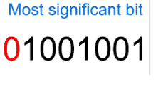
the most significant bit (MSB)
In computing, the most significant bit (MSB, also called the high-order bit) is the bit position in a binary number having the greatest value. The MSB is sometimes referred to as the left-most bit due to the convention in positional notation of writing more significant digits further to the left.

Slide 11
Exercise
Convert decimal 25 to a binary number

Slide 12
Binary to Decimal
Technique
Multiply each bit by 2^{n}, where n is the “weight” of the bit
The weight is the position of the bit, starting from 0 on the right
Add the results

Slide 13
Example
Bit “0”
101011₂ => 1 x 2⁰ = 1 1 x 2¹ = 2 0 x 2² = 0 1 x 2³ = 8 0 x 2⁴ = 0 1 x 2⁵ = 32
43₁₀

Slide 14
Exercise
Convert 111001 binary number to a decimal

Slide 15
Decimal to Hexadecimal
Technique
Divide by 16
Keep track of the remainder

Slide 16
Example
1234₁₀ = ?₁₆
16 1234
77 2
16
4 13 = D
16
0 4
1234₁₀ = 4D2₁₆

Slide 17
Exercise
Convert decimal 2468 to a hex number

Slide 18
Hexadecimal to Decimal
Technique
Multiply each bit by 16^{n}, where n is the “weight” of the bit
The weight is the position of the bit, starting from 0 on the right
Add the results

Slide 19
Exercise
Convert hex number to a decimal

Slide 20
Hexadecimal to Binary
Technique
Convert each hexadecimal digit to a 4-bit equivalent binary representation

Slide 21
Example
10AF₁₆ = ?₂
1 0 A F
0001 0000 1010 1111
10AF₁₆ = 0001000010101111₂

Slide 22
Binary to Hexadecimal
Technique
Group bits in fours, starting on right
Convert to hexadecimal digits

Slide 23
Example
1010111011₂ = ?₁₆
10 1011 1011
B B
1010111011₂ = 2BB₁₆

Slide 24
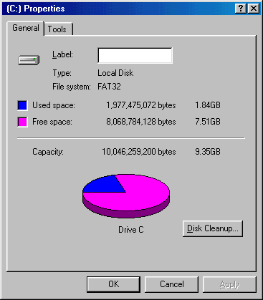
Example
In the lab… 1. Double click on My Computer 2. Right click on C: 3. Click on Properties
/ 2³⁰ =

Slide 25
Home Work ?
Convert the following Decimal numbers to binary
25
32
64
128
255
511
Convert the following binary numbers to decimal
111111
100000
11
111
10000
101010

Slide 26
Exercise 1.3

